Slide 2
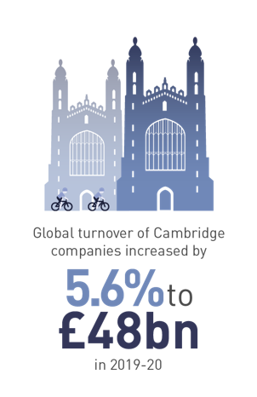
Cambridge is Europe’s leading innovation ecosystem
5,300+ knowledge intensive firms and 800 knowledge-intensive services companies
Research Institutions employ over 37,000 people
Global turnover of Cambridge companies was £48 billion in 2019 – 20
Life Sciences/Healthcare cluster turnover of £7 billion
Tech cluster turnover of £5 billion
Advanced Manufacturing turnover of £6 billion

Slide 3
The Cambridge ecosystem is based on five key components that work together to drive innovation
Talent & Skills
Knowledge Engine

Slide 4
Cambridge’s ground-breaking ideas are developed by a world-leading workforce
3rd
University innovation
ecosystem WW
67,800+
Employees within knowledge-intensive firms
309
Patent applications per 100,000 (#1 in the UK)
87%
University research deemed world-leading or internationally excellent
Source: “Cambridge innovation in numbers”, The University of Cambridge, 2020 and 2021
4

Slide 5
The Cambridge ecosystem is based on five key components that work together to drive innovation
Space and Infrastructure
Talent & Skills
Knowledge Engine

Slide 6
Cambridge is distinctive for its concentration of specialist campuses, with over 30 science and tech parks
We are here
Source: Cambridge University Health Partners
Notes:
Biomedical Campus: Europe’s largest centre of medical research and is home to AstraZeneca and GlaxoSmithKline, as well as Addenbrooke’s Hospital.

Slide 7
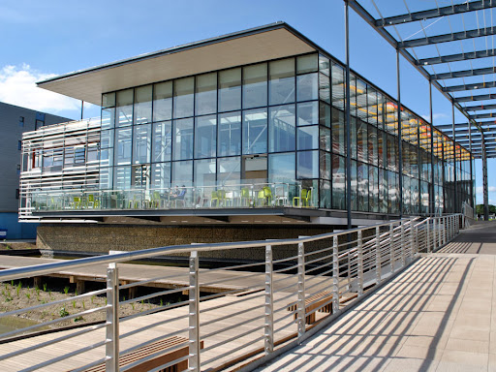
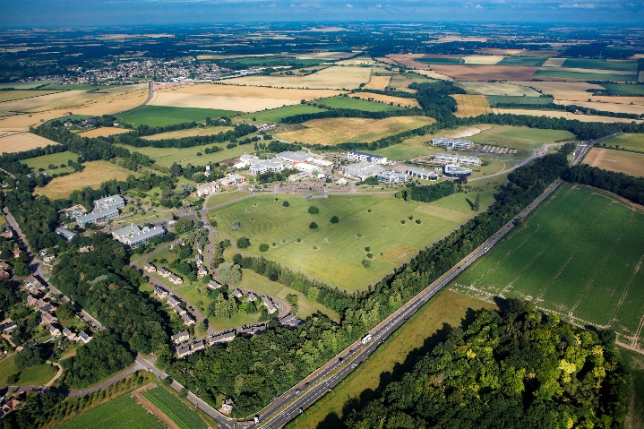
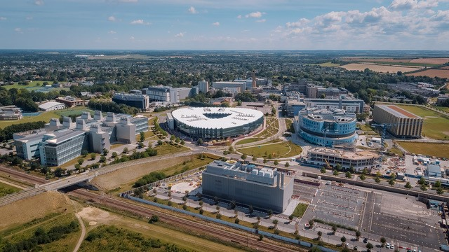
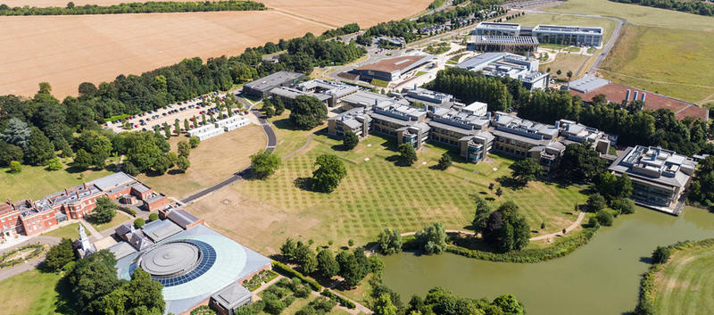
Cambridge is distinctive for its concentration of specialist campuses, with over 30 science and tech parks
West Cambridge Site
Cambridge Biomedical Campus
Babraham Research Campus
Wellcome Genome Campus
We are here
Source: Cambridge University Health Partners
Notes:
Babraham: nationally and internationally renowned as a leading UK centre of excellence in antibody based therapeutics, the original home of Cambridge Antibody Technology (CAT) that was acquired by MedImmune and led to AstraZeneca bringing its global HQ to Cambridge
Cambridge BioMedical Campus: a vibrant and ground breaking healthcare community at the forefront of science and medicine. Includes the AstraZeneca HQ, Abcam and next to Addenbrookes Hospital
West Cambridge: The University’s vision is for it to be a world-class, well connected research and development environment that benefits Cambridge, the region and the UK – one that provides facilities that help the University to retain its globally competitive position by continuing to attract and retain the world's best academics and researchers, as well as one that supports entrepreneurship and collaboration with industry. Great things are happening there in physical sciences including the new Cavendish building
The Wellcome Genome Campus: is home to some of the worlds foremost institutes and organisations in genomics and computational biology, committed to delivering life changing science with the reach, scale and imagination to solve some of humanity’s greatest challenges

Slide 8
The Cambridge ecosystem is based on five key components that work together to drive innovation
Space and Infrastructure
Talent & Skills
Investment and Professional Services
Knowledge Engine

Slide 9
Investment into IP-rich companies continues to increase, propelling start-ups to greater valuations at a higher frequency
£20m - £50m
£50m+
2021
2021
17
~2x
~2x
2016
2016
£50m+
£20m - £50m
~£1.3B
Investment in IP-rich Cambridge companies in 2021
~2x
More growth rounds for Cambridge companies since 2016
2017-21
2.5x
2021
2012-16
10
IPOs of IP-rich companies between 2017-21
23
Billion dollar companies created in Cambridge to date
Source: CIC analysis, Beauhurst, Pitchbook

Slide 10
The Cambridge ecosystem is based on five key components that work together to drive innovation
Community Support
Space and Infrastructure
Talent & Skills
Investment and Professional Services
Knowledge Engine

Slide 11
Multiple networks exist across Cambridge which bring people together, exemplified by Cambridge&
Opportunity to create a…
Mission to…
“One-stop-shop” to showcase Cambridge to the world
Single source of “truth” about our innovation ecosystem and what it has to offer
Champion to communicate how Cambridge is affecting the world
Conductor to coordinate key stakeholders to effectively enact positive global change
Attract high quality global investors in knowledge intensive industries
Raise Cambridge’s profile as a true world-leading innovation ecosystem
Identify where Cambridge can be world-leading and ensure there is a specialist ecosystem to fulfil its potential
Bring high quality multi-national corporations to the region
Solution:
Created in 2020 as a non-profit, joint initiative by the University of Cambridge, Cambridge Innovation Capital and the Greater Cambridge Partnership, with support across all key stakeholder groups

Slide 12
Examples of recent opportunities
A national dementia investment
Regional and national airports
A global research institute based in Asia
A leading Manchester-based investment firm
A scaling US Quantum Computer company

Slide 13
The Cambridge ecosystem is based on five key components that work together to drive innovation
Community Support
Space and Infrastructure
Talent & Skills
Investment and Professional Services
Knowledge Engine

Slide 14
The level of innovation and entrepreneurship activity in Cambridge has become self-propagating
IP-intensive business founded
Venture investment from CIC and others
Partnerships / IPO / acquisition
Exceptional talent and infrastructure available
14
Notes:
The birth-rate of Life Sciences and Healthcare Companies in Cambridge has more than doubled in the last year

Slide 15
FOR FURTHER INFORMATION AND SUPPORT
Harriet Fear, Director
harriet@cambridgeand.com
www.cambridgeand.com
LinkedIn: cambridgeand
Tel: 07555 297622

